Slide 1

HR Analytics Dashboard
Capstone Project Report
Project Id: PTID-CDA-NOV-25-918
Project Code: PRDA-03
Batch Code: 14-JUL-25-CDA-BUN-040-WDM0900-BAN
Prepared By: Satyam Dash (dashsatyam510@gmail.com)
Institute: DataMites

Slide 2




Dashboard Overview
Total Employees
Work Location
Complete workforce metrics and demographics
Remote vs HQ distribution analysis
Hiring Trends
Demographics
Year-over-year recruitment patterns
Gender, state, department, and race breakdown
This dashboard provides a complete summary of the HR dataset with interactive slicers for Location, Department, Gender, and Hire Year.

Slide 3
Key Metrics
22K
24.75%
75.25%
41.61
Total Employees
Remote Workers
HQ Workers
Average Age
Current workforce size
Work from home
Office-based staff
Years across workforce
Workforce Stability
Succession Planning
The workforce is mostly HQ-based, indicating traditional office culture.
Average age shows a mature workforce, indicating stability but also a need to prepare for future retirements.

Slide 4


Hiring Trend Insights
1
2003-2005
Hiring peaked around 1,000 employees
2
2006-2017
Remained stable for most years
3
2018-2020
Slight decline after 2018
Interpretation: Company hiring has been stable but shows a recent slowdown. Could indicate cost control or hiring freeze.

Slide 5
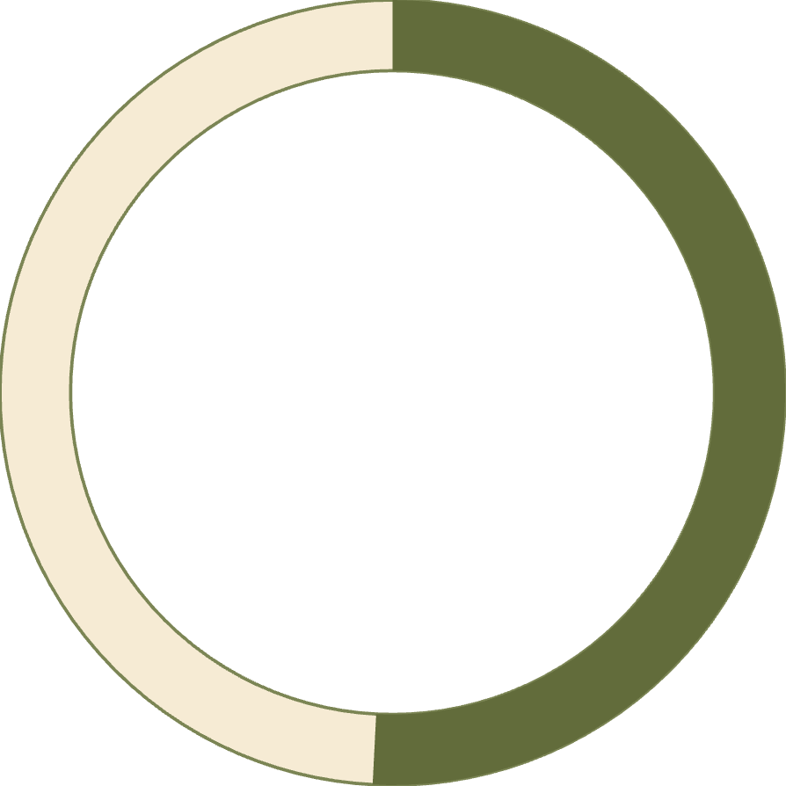


Gender Insights
50.81%
46.46%
2.72%
Female
Male
Non-Conforming
11.29K employees
10.32K employees
0.61K employees
Interpretation: Gender ratio is balanced. Non-conforming employees represent a small but important demographic.

Slide 6
Employees by State
81.9%
5.0%
3.9%
Ohio
Pennsylvania
Illinois
18,025 employees
1,115 employees
868 employees
3.2%
3.0%
Indiana
Michigan
700 employees
673 employees
Critical Risk: Workforce is heavily concentrated in Ohio. Company relies on a single state → Risk during disruptions (regulation, weather, market).

Slide 7
Employees by Department
Engineering
Accounting
Sales
6,686 employees
3,333 employees
1,832 employees
Largest function
Financial operations
Revenue generation
Human Resources
Training
1,807 employees
1,692 employees
People management
Development focus
Interpretation: Engineering is the largest function → tech-focused company. Accounting is the second → indicates large financial ops.

Slide 8
Employees by Race
White
Two or More Races
Black or African American
6,328 employees
3,648 employees
3,619 employees
Asian
Hispanic or Latino
3,562 employees
2,501 employees
Interpretation: Workforce diversity is strong. Representation gap exists for Hispanic and Native American employees.

Slide 9
Insights Summary
01
02
03
Gender Balance
Geographic Concentration
Engineering Focus
Balanced gender ratio across the organization
Majority of employees are in HQ and in Ohio
Engineering is the biggest department
04
05
Stable Hiring
Diversity Progress
Hiring trend is stable with recent dips
Diverse workforce but certain groups under-represented

Slide 10
Recommendations
1
2
3
Improve Workforce Distribution
Strengthen Remote Work Policy
Diversity Initiatives
Recruit more Hispanic and Native American candidates. Continue diversity training.
Reduce dependency on Ohio. Expand hiring in other states.
24.75% remote is good but can grow. Helps lower office cost and improves employee satisfaction.
4
5
Prepare for Future Age Gaps
Increase Hiring in Growth Areas
Average age is 41.61 → plan mentorship + succession strategy.
Technical (Engineering), Operations & HR, Data teams

Slide 11

THANK YOU

